Slide 1
AI for Anomaly Detection
Notes:
Welcome to AI for Anomaly Detection.
In this course, you’ll learn to apply three AI approaches to the problem of Anomaly Detection. Specifically, we’re going to address the problem of detecting network intrusions in a scalable way using both supervised and unsupervised methods.

Slide 2
Professional Data Science Background with Python
Basics of Deep Learning – Have trained a DNN
Prerequisites
Notes:
This course is designed for people who have professional experience in data science, specifically with Python, along with some exposure to deep learning. If you have trained a neural network, you should be fine.

Slide 3
Introduction to Anomaly Detection
Supervised Learning with XGBoost
Break
Unsupervised Learning with Autoencoders
Unsupervised Learning with GANs
Assessment: Apply one technique to a new dataset
Agenda
Notes:
Throughout the day, you’ll learn the following techniques by working to solve the same problem: Detecting network intrusions. You will likely see many other applications for what you’ll learn, but we’ll use this use case so you have something real to attach it to. By the end of the day, you should be able to apply any of these techniques to a new dataset and detect anomalies.

Slide 4
Introduction to Anomaly Detection

Slide 5

WHAT IS AN ANOMALY?
A data point which differs significantly from other data points
An observation that is likely generated by a different mechanism
Finding anomalies can be useful in telecom/sp networks, cyber security, finance, industry, IOT, healthcare, autonomous driving, video surveillance, robotics.
Many other problems can be framed as anomaly detection: customer retention, targeted advertising.

Slide 6

SPOT THE ANOMALY

Slide 7

SPOT THE ANOMALY

Slide 8

EXERCISE
What are some of the scenarios that produce anomalies in your organization/domain?
What data sources might affect or record those anomalous activities?
What kind of data analytics techniques could be applied or have been applied to detect those events?

Slide 9
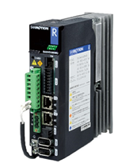



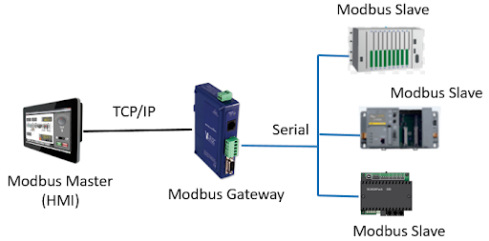

Why is Anomaly Detection Important?
Case Study
Supervisory control and data acquisition (SCADA)
Programmable Logic Controllers (PLCs)

Slide 10
The Stuxnet Worm
Case Study
A 500-kilobyte malicious computer worm that targets SCADA systems.
Spread:
Through infected removable drives such as USB flash drives.
Operation:
Analyzed and targeted Windows networks and computer systems.
Compromised the Step7 software, the worm gained access to 45 S7 to the PLCs.
Virus modified project communication configurations for the PLC’s Ethernet ports
Result:
Infected over 100,000 computers & 22 Manufacturing sites
Appears to have impacted Natanz nuclear facility destroying 984 uranium enriching centrifuges.

Slide 11
DATASET
At a glance!
Name | KDD99 Intrusion Detection Dataset Publicly available at http://kdd.ics.uci.edu/databases/kddcup99/kddcup99.html
Size | 743 Mb
No. of Features | Numeric = 22 ; Categorical = 9
No. of Rows | 18 Million
No. of Classes | 23 (Including the Normal category)
Variable Types | Numeric & Categorical
Goal | Detect Anomalies by studying Network Packet logs

Slide 12
DATASET
Basic Features | Content Features | Traffic Features
duration | hot | count
protocol_type | num_failed_logins | serror_rate
service | logged_in | rerror_rate
src_bytes | num_compromised | same_srv_rate
dst_bytes | root_shell | diff_srv_rate
flag | su_attempted | srv_count
land | num_root | srv_serror_rate
wrong_fragment | num_file_creations | srv_rerror_rate
urgent | num_shells | srv_diff_host_rate
 | num_access_files
 | num_outbound_cm
 | is_hot_login
 | is_guest_login
Numerical
Categorical
Detailed Description @
https://kdd.ics.uci.edu/databases/kddcup99/task.html

Slide 13
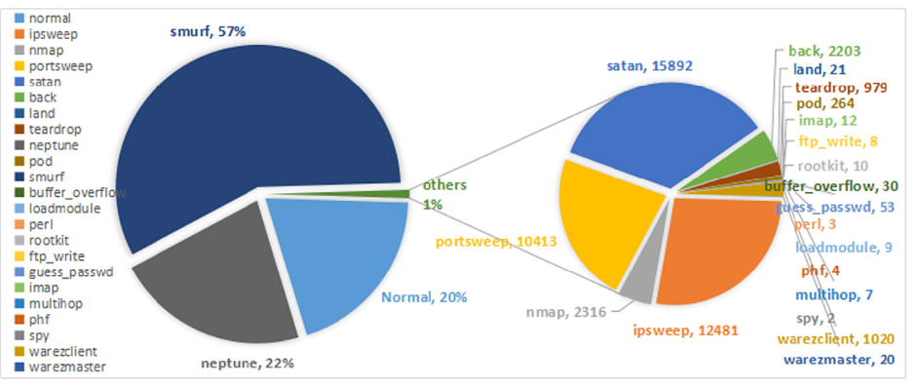
DATASET
Visualization by class

Slide 14
Handling Time Series Data
For Classification
Averaging Features
Duration | Feature 1 | Feature 2 | Feature 3
1 | Avg(Val_1,Val_4) | Avg(Val_2,Val_5) | Avg(Val_3,Val_6)
1 | Avg(Val_7,Val_10) | Avg(Val_8,Val_11) | Avg(Val_9,Val_12)
Time | Feature 1 | Feature 2 | Feature 3
00:00:00 | Val_1 | Val_2 | Val_3
00:00:01 | Val_4 | Val_5 | Val_6
00:00:02 | Val_7 | Val_8 | Val_9
00:00:03 | Val_10 | Val_11 | Val_12
Sampling Features
Duration | Feature 1 | Feature 2 | Feature 3
1 | Val_4 | Val_5 | Val_6
1 | Val_10 | Val_11 | Val_12

Slide 15
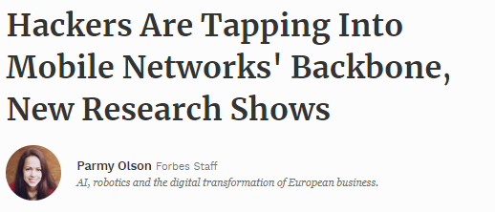
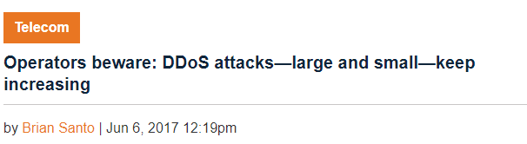
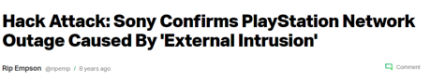
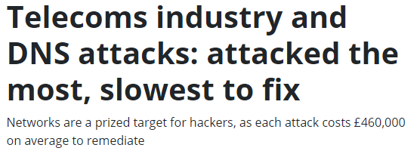
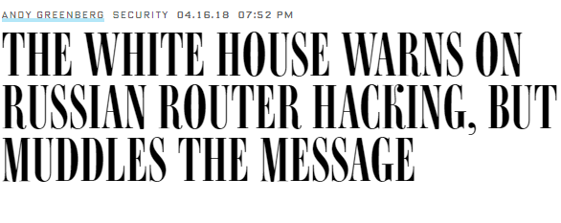
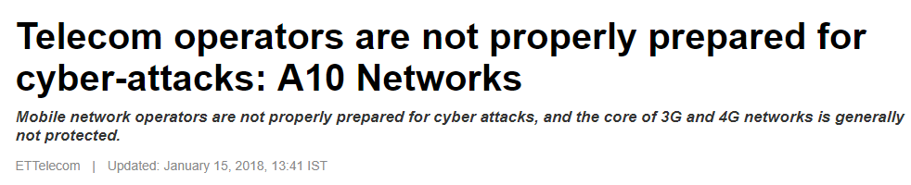
IN THE NEWS
https://www.forbes.com/sites/parmyolson/2015/10/14/hackers-mobile-network-backbone-ss7/#59d777f85142
https://techcrunch.com/2011/04/23/hack-attack-sony-confirms-playstation-network-outage-caused-by-external-intrusion/
https://www.information-age.com/telecoms-industry-dns-attacks-attacked-slowest-fix-123469037/
https://www.wired.com/story/white-house-warns-russian-router-hacking-muddles-message/
https://telecom.economictimes.indiatimes.com/news/telecom-operators-are-not-properly-prepared-for-cyber-attacks-a10-networks/62504221

Slide 16
ANOMALY DETECTION IN NETWORKS
Why do we need it in Telecom ?
What sort of data can we leverage?
NetFlow Data
Telecom Fraud
$38 Billion
Time Series Based
Encrypted Traffic Data
Machine Exhaust Data
Network Anomaly Detection
Network / IP Fraud $12 Billion
Equipment/User Metadata
Feature Based
Aggregations
Temporal Features

Slide 17


DETECTION METHODS IN THIS COURSE
Anomaly Detection
Supervised
(When you have Labels)
Unsupervised
(When you don’t have labels for your data)
XGBoost
Autoencoders
Generative Adversarial Networks

Slide 18
GPU ACCELERATED XGBOOST

Slide 19



XGBOOST
Definition
XGBoost is an implementation of gradient boosted decision trees designed for speed and performance.
It is a powerful tool for solving classification and regression problems in a supervised learning setting.
Notes:
The input is usually a vector.
[ˈneɪbə^{r}]

Slide 20
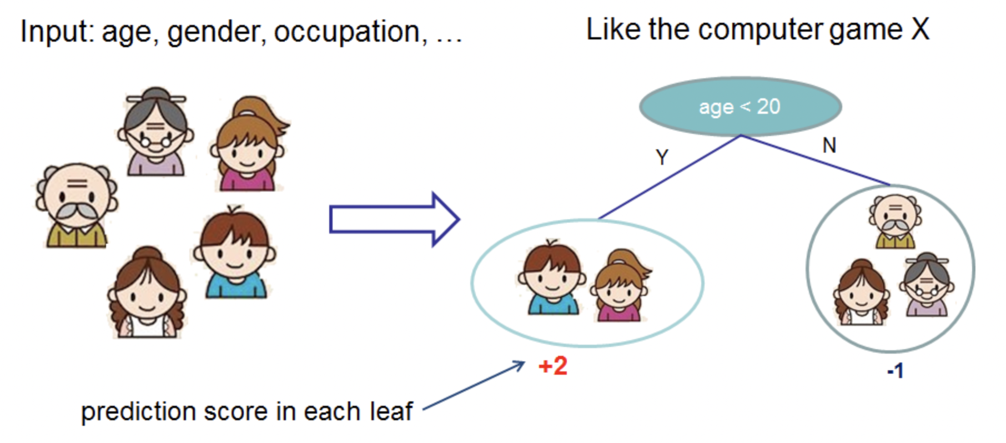
PREDICT: WHO LIKES COMPUTER GAME X
Example of Decision Tree
Source: https://goo.gl/eTxVtA

Slide 21
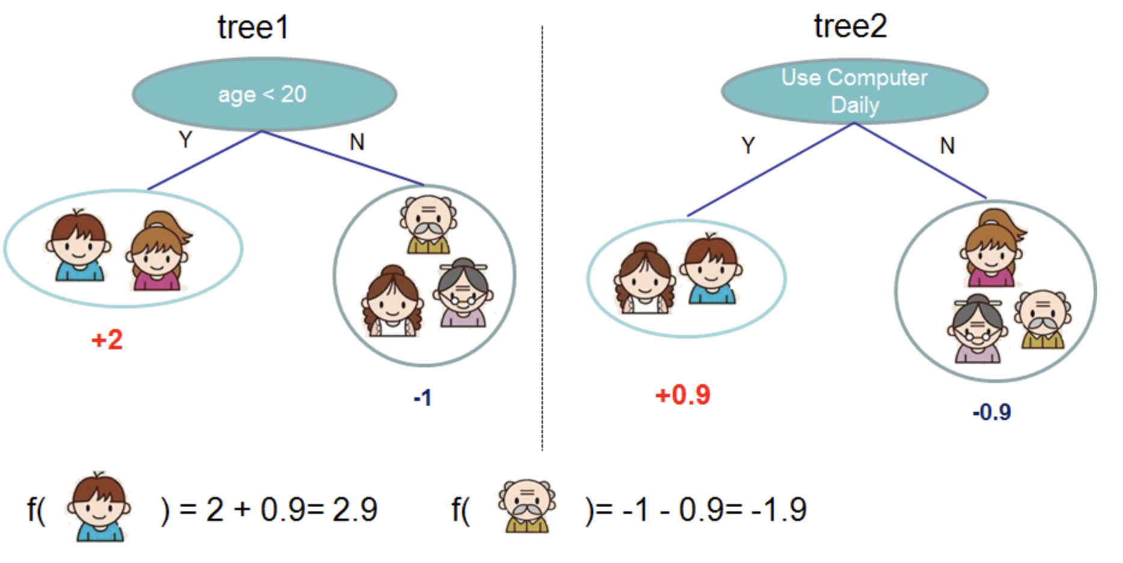
ENSEMBLED DECISION TREES
Source: https://goo.gl/eTxVtA

Slide 22
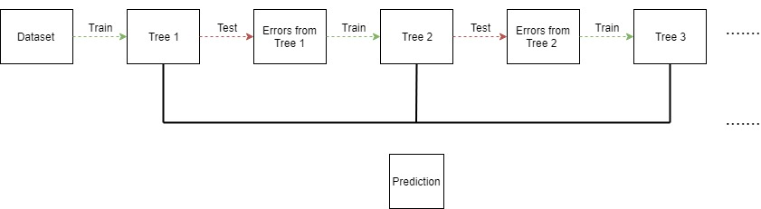
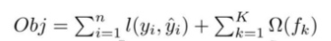
GRADIENT BOOSTED TREES FOR STRONGER PREDICTIONS
Complexity of the Trees
Build trees one at a time, where each new tree helps to correct errors made by previously trained tree.
Training Loss

Slide 23
XgBoost
Intuitive Example for Tree Construction
Step 1: Start as a single leaf
Input all residuals
-10.5, 6.5, 7.5, -7.5
15
10
Step 2: Calculate similarity score
For all residuals
Set Threshold @ Arbitrary Drug Dosage 15
Sum of residuals squared
No. of residuals + Regularization
0
Effectiveness
-10.5, 6.5, 7.5, -7.5
S0 = 4
Setting Reg = 0
-15
0
20
40
Drug Dosage
https://www.youtube.com/watch?v=OtD8wVaFm6E

Slide 24
XgBoost
Intuitive Example for Tree Construction
Step 3: Calculate Similarity Score
For Left and Right Sub Trees
-10.5, 6.5, 7.5, -7.5
15
10
S10 = 110.25
Setting Reg = 0
-10.5
6.5, 7.5, -7.5
S11 = 14.08
Setting Reg = 0
0
Effectiveness
Step 4: Calculate Gain
Lower Leaves cluster similar residuals than root ?
Gain = Left Similarity + Right Similarity
– Root Similarity
-15
0
20
40
G1 = 120.33
Drug Dosage

Slide 25
XgBoost
Intuitive Example for Tree Construction
Step 5: Calculate Similarity Score
For Left and Right Sub Trees
Dosage < 22.5
22.5
10
S10 = 8
Setting Reg = 0
-10.5 , 6.5
7.5, -7.5
S11 = 0
Setting Reg = 0
0
Effectiveness
Step 6: Calculate Gain
Lower Leaves cluster similar residuals than root ?
Gain = Left Similarity + Right Similarity
– Root Similarity
-15
0
20
40
G2 = 4
Drug Dosage
Since G2 = 4 < G1 = 120.33
Tree 1 had better split

Slide 26
XgBoost
Intuitive Example for Tree Construction
Step 7: Calculate Similarity Score
For Left and Right Sub Trees
Dosage < 30
30
10
S10 = 4.08
Setting Reg = 0
-10.5 , 6.5, 7.5
-7.5
S11 = 56.25
Setting Reg = 0
0
Effectiveness
Step 6: Calculate Gain
Lower Leaves cluster similar residuals than root ?
Gain = Left Similarity + Right Similarity
– Root Similarity
-15
0
20
40
G3 = 56.33
Drug Dosage
Since G3 = 56.33 < G1 = 120.33
Tree 1 had better split

Slide 27
XgBoost
Intuitive Example for Tree Construction
Dosage <15
22.5
10
S10 = 110.25
Setting Reg = 0
-10.5
Dosage < 22.5
S11 = 14.08
Setting Reg = 0
0
Effectiveness
Step 8: Calculate Similarity Score
For Left and Right Sub Trees ( 2nd Level)
-15
S21 = 42.25
Setting Reg = 0
6.5
7.5, -7.5
S21 = 0
Setting Reg = 0
0
20
40
Drug Dosage
Step 9: Calculate Gain
Lower Leaves cluster similar residuals than root ?
G12 = 42.25 – 14.0 = 28.17

Slide 28

XgBoost
Intuitive Example for Tree Construction
Step 10: Calculate Similarity Score
For Left and Right Sub Trees
Dosage <15
30
10
S10 = 110.25
Setting Reg = 0
-10.5
Dosage < 22.5
S11 = 14.08
Setting Reg = 0
0
Effectiveness
Output = -10.5
Step 11: Calculate Gain
Lower Leaves cluster similar residuals than root ?
-15
S21 = 98
Setting Reg = 0
6.5, 7.5
-7.5
S21 = 56.25
Setting Reg = 0
0
20
40
Drug Dosage
G21 = 140.17 > G12
Step 12:
Calculate Output Value =
Sum of residuals
Output = 7
Output = -7.5
No. of residuals + Regularization

Slide 29
XgBoost
Intuitive Example for Tree Construction
Re - Calculate Residuals :
Assuming Gradient Multiplier = 0.3
R1 : 0.5 + 0.3 (-10.5) = - 2.65
R2 : 0.5 + 0.3(7) = 2.6
R3 : 0.5 + 0.3(7) = 2.6
R4 : 0.5 + 0.3(-7.5) = -1.75
Dosage <15
S10 = 110.25
Setting Reg = 0
-10.5
Dosage < 22.5
S11 = 14.08
Setting Reg = 0
Output = -10.5
Step 13:
Construct new tree with updated Residuals
S21 = 98
Setting Reg = 0
6.5, 7.5
-7.5
S21 = 56.25
Setting Reg = 0
G21 = 140.17 > G12
Output = 7
Output = -7.5

Slide 30
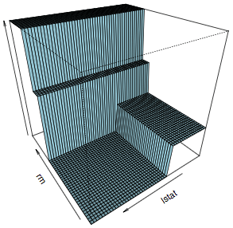
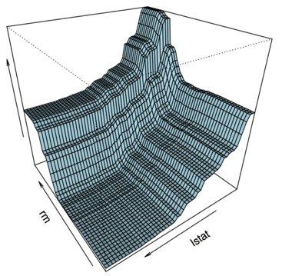
TRAINED MODELS VISUALIZATION
Single Decision Tree vs Ensembled Decision Trees
Models fit to the Boston Housing Dataset
Source: https://goo.gl/GWNdEm

Slide 31
XgBoost
XgBoost
Gradient Boosting
Boosting
Decision Trees
Random Forest
Bagging
Optimized version of GBT incorporating parallelism, tree pruning and regularization.
Building up from a Decision Tree
Utilize Gradient Descent to minimize errors in the sequentially built trees.
Trees built sequentially minimizing errors from previous trees and weighing better performing ones more.
Utilize random subsets of a dataset to build multiple decision trees
Ensemble of multiple decision trees to arrive at decision through majority voting
Tree based algorithm that outputs decisions based on certain conditions.

Slide 32
WHY XGBOOST?

Slide 33

ROC CURVE
Construction
Move Threshold
 |  | Actual
 |  | Anomaly | Not Anomaly
Predicted | Anomaly | TP | FP
 | Not Anomaly | FN | TN
1
True Positive Rate
True Positive Rate
TP / (TP+FN) = Sensitivity
False Positive Rate
FP / (FP +TN)
0
1
False Positive Rate
https://www.youtube.com/watch?v=4jRBRDbJemM

Slide 34
ROC CURVE
Construction
Move Threshold
 |  | Actual
 |  | Anomaly | Not Anomaly
Predicted | Anomaly | TP | FP
 | Not Anomaly | FN | TN
1
True Positive Rate
AUC
True Positive Rate
TP / (TP+FN) = Sensitivity
False Positive Rate
FP / (FP +TN)
0
1
False Positive Rate

Slide 35
ROC CURVE
Interpretation
True Positive Rate
Number of Samples
AUC = 0.99 ~1
0
1
0
1
0.5
False Positive Rate
Probability Score

Slide 36
ROC CURVE
Interpretation
True Positive Rate
Number of Samples
AUC = 0.5
0
0.5
1
0
1
False Positive Rate
Probability Score
Better the separation between the classes = Better Model / Classifier

Slide 37
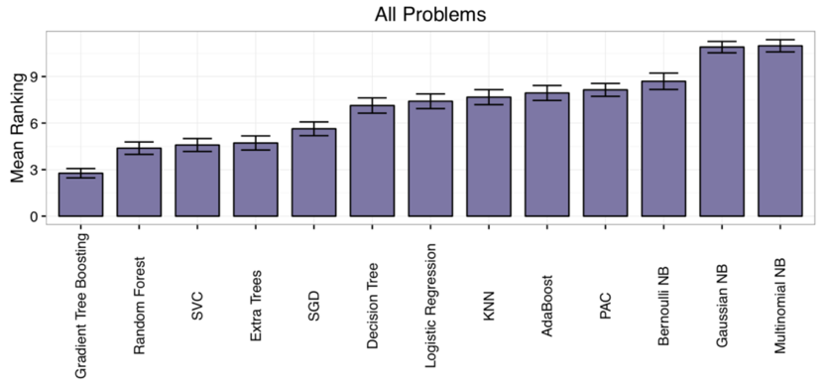
WHICH ML ALGORITHM PERFORMED BEST
Average rank across 165 ML datasets
Lower
Is
Better
Source: https://goo.gl/R8Y8Pp

Slide 38

RAPIDS
End-to-End Accelerated GPU Data Science
Data Preparation
Model Training
Visualization
Dask
cuDF cuIO
Analytics
cuML
Machine Learning
cuGraph
Graph Analytics
PyTorch, TensorFlow, MxNet
Deep Learning
cuxfilter, pyViz, plotly
Visualization
GPU Memory
Notes:
RAPIDS is an open source framework which tries to accelerate the end-to-end
data science pipeline by using GPUs and GPU memory rather than CPU and CPU
memory.
It is a set of libraries, and each of them covers a different objective.
Today, we will focus on a couple of these libraries:
cuDF for data prep and feature engineering and cuML, which is the library
which contains the most used machine learning algorithms, such as PCA, K-Means,
KNN, and many others.
Nevertheless, there are other libraries which I would like to mention too.
We have recently released a new library, cuGraph, for graph analytics.
Also, we will be releasing soon a library named cuIO, for ETL purposes.
For data visualization we have cuXFilter, a JavaScript library based on
CrossFilter, and which allows you to explore datasets in the browser.

Slide 39
WHY RAPIDS + XGBOOST?

Slide 40
TIME TO TRAIN
Rapid Data Science
Model Selection and Hyper-Parameter Tuning
best_model = init_model
for (m,h) in zip(models, hyperparams):
my_model = train(m,h)
if acc(my_model) > acc(best_model):
best_model = my_model
Test Set Accuracy
Test Set Accuracy
Size of Training Data
Number of Models Trained

Slide 41
RAPIDS WITH XGBOOST
Multi-GPU, Multi-Node, Scalability
XGBoost:
Algorithm tuned for eXtreme performance and high efficiency
Multi-GPU and Multi-Node Support
RAPIDS:
End-to-end data science & analytics pipeline entirely on GPU
User-friendly Python interfaces
Relies on CUDA primitives, exposes parallelism and high-memory bandwidth
Benefits from DGX system designs (NVLINK, NVSWITCH, dense compute platform)
Dask integration for managing workers & data in distributed environments

Slide 42
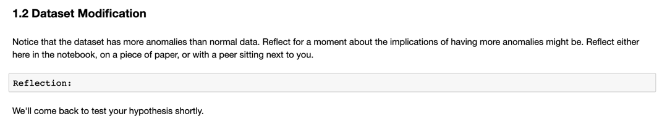
Work through the first reflection
Notes:
Host a discussion

Slide 43
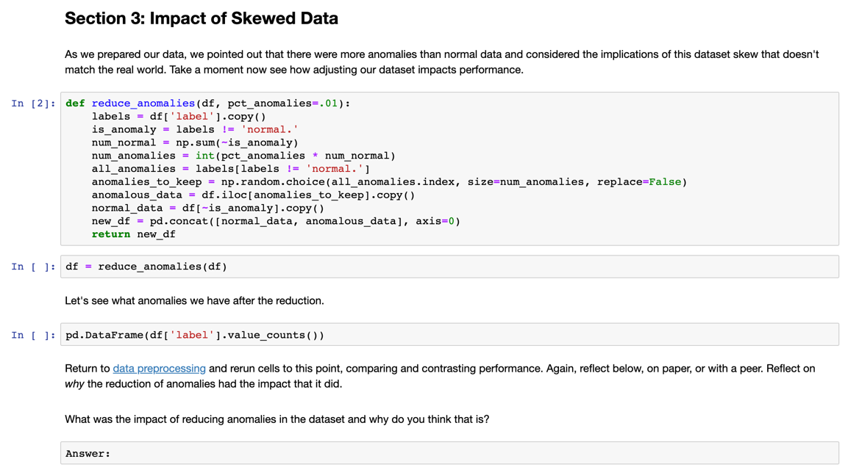
Train a binary classifier and stop here
Notes:
Guide students to implement and rerun everything hosting a discussion after.

Slide 44
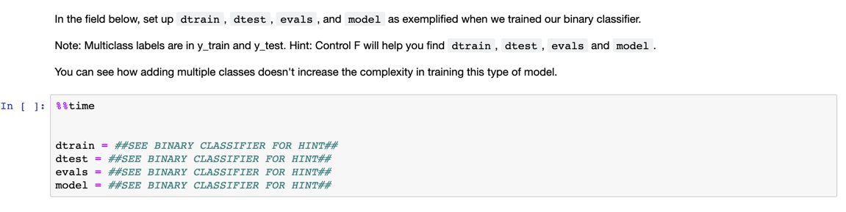
Multi-Class Classifier Challenge
Notes:
Guide students to implement and rerun everything hosting a discussion after.

